Slide 1

Artificial Life
Python Simbots

Slide 2
A-Life
A-Life is a field of study wherein researchers examine systems related to natural life, its processes, and its evolution, through the use of simulations with computer models, robotics, and biochemistry.
from https://en.wikipedia.org/wiki/Artificial_life

Slide 3
After you have learned GA, used for creating fuzzy rules for you
This assignment is about to extend the algorithm a little bit.
Since GA emulates the process of evolution
considered as a natural process of many living things.
Instead of looking the process by fixed time of many generations,
this time, all living things will be live their lives until they die.
One who lives longer
have more chances to reproduce or spread some of its DNA into the population.
Once there is someone to die,
the nature is called upon to create a new individual by mating a couple from the remaining population.
When the time goes on,
the improved ones survive and live their lives,
finally become the dominated ones.

Slide 4
To create an Artificial Life, these are the steps ..
At start, a population of 20 robot individuals is generated. As usual, their chromosomes are randomly formed. To stay alive, all robots must have their energy (they were born with 300).
The energy is not only decreased every time, but also consumed more when the robot is not in its well status.
For example, if the robot hits something, the energy is spent faster. Other usual statuses are lazy, headache, and etc.
In the environment, all robots are put into the test. (The energy is the key)
To live longer, the robots have to preserve their energy and to find food getting more additional energy to life.
Food are limited, but not empty. If one food was taken, another food is formed in another place randomly located.
Each robot is able to see others. Therefore, other robots are considered as moving obstacles. There are also static obstacles, which are not moving at all.
When one robot dies, the process to generate the new robot is taking place for replacing the dead.
A couple of robots are randomly picked from the remaining ones in the population.
Then, the crossover is called to reproduce a new robot from its parents.
In addition, mutation is also applied rarely.
The simulation time is counting continuously until reaching the maximum tick (100000).
Learning curve is plotted from amount of dead robots in different time intervals.
At the end, the robot with highest energy is selected to be the final answer.

Slide 5
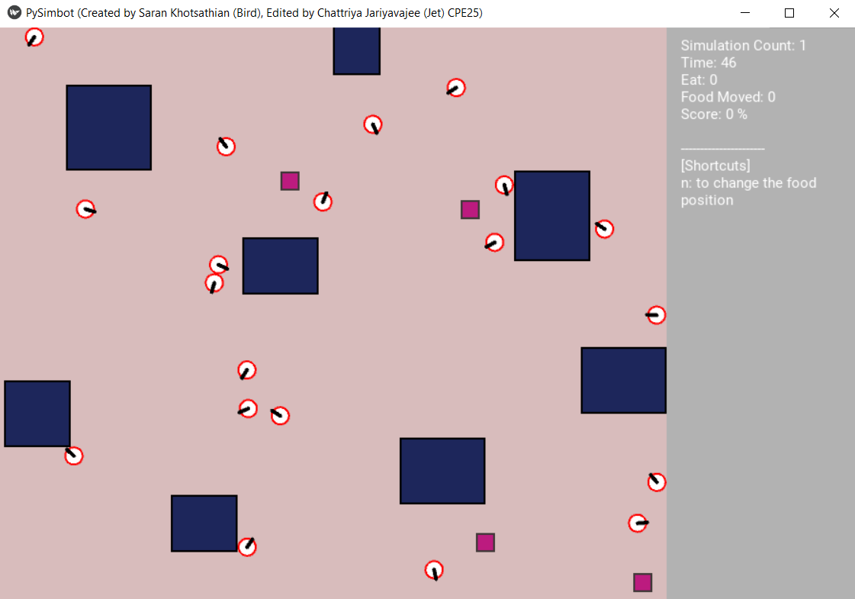

Slide 6
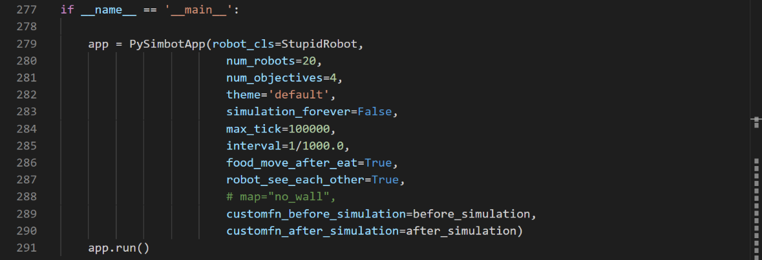

Slide 7
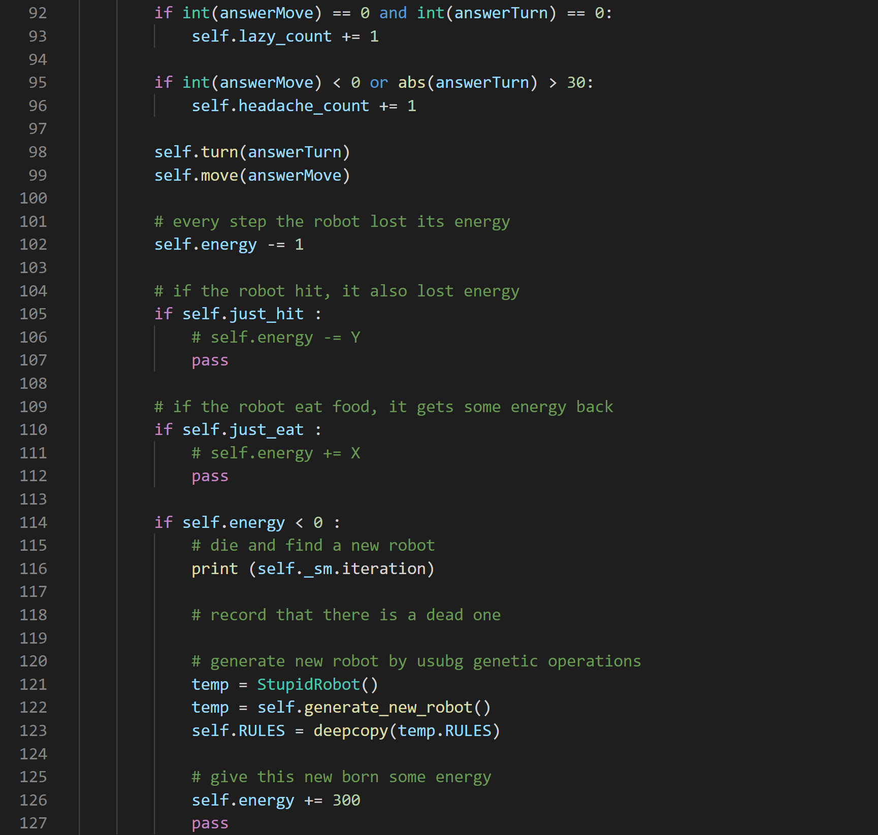

Slide 8
